Slide 1
Architectural Acoustics
Week 5: Building Acoustics
Lecture B.3
Jieun Yang (j.yang3@tue.nl) Assistant professor, Building Acoustics group

Slide 2

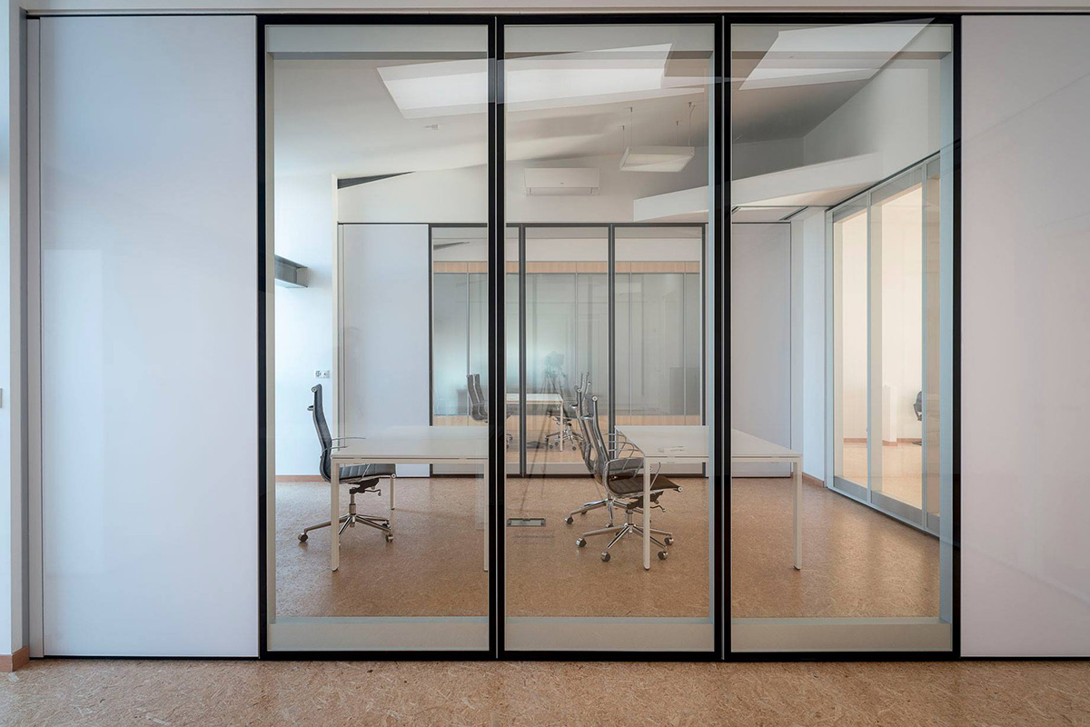
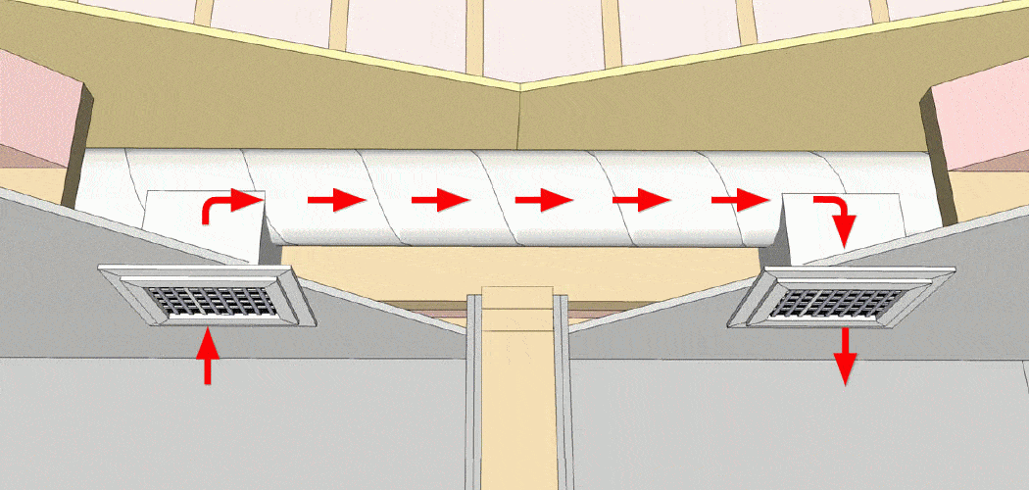
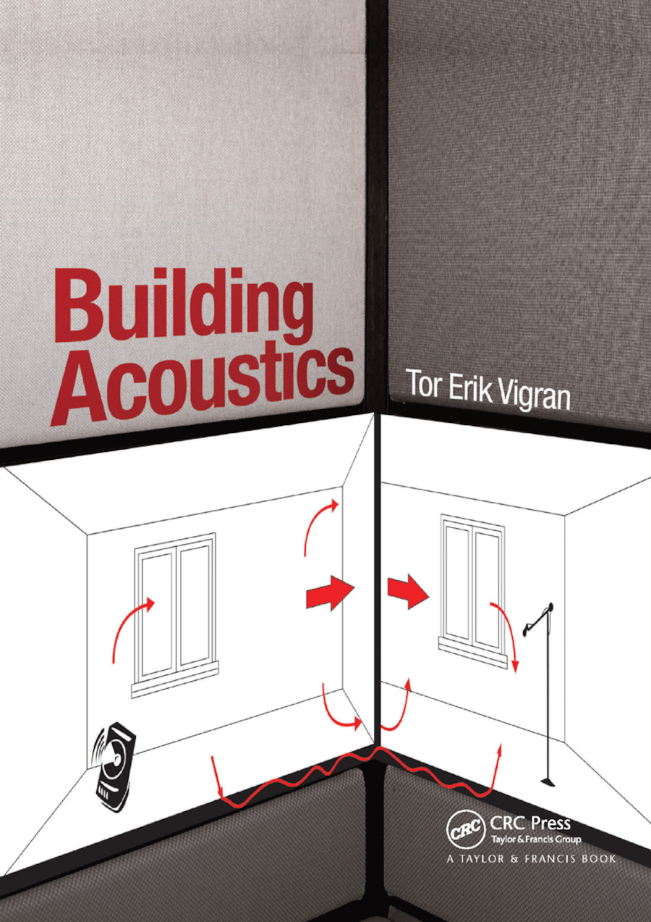
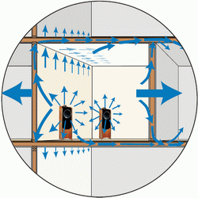
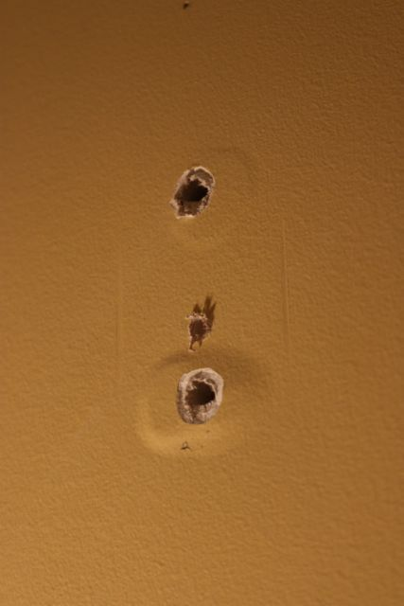
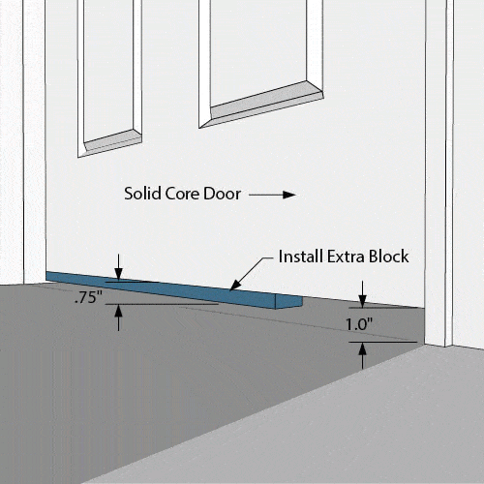
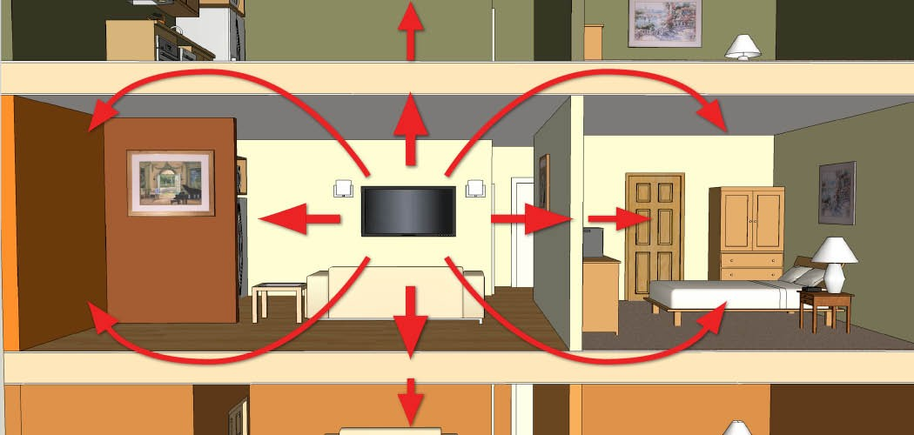
Introduction: Lecture B.3
Sound reduction index

Slide 3
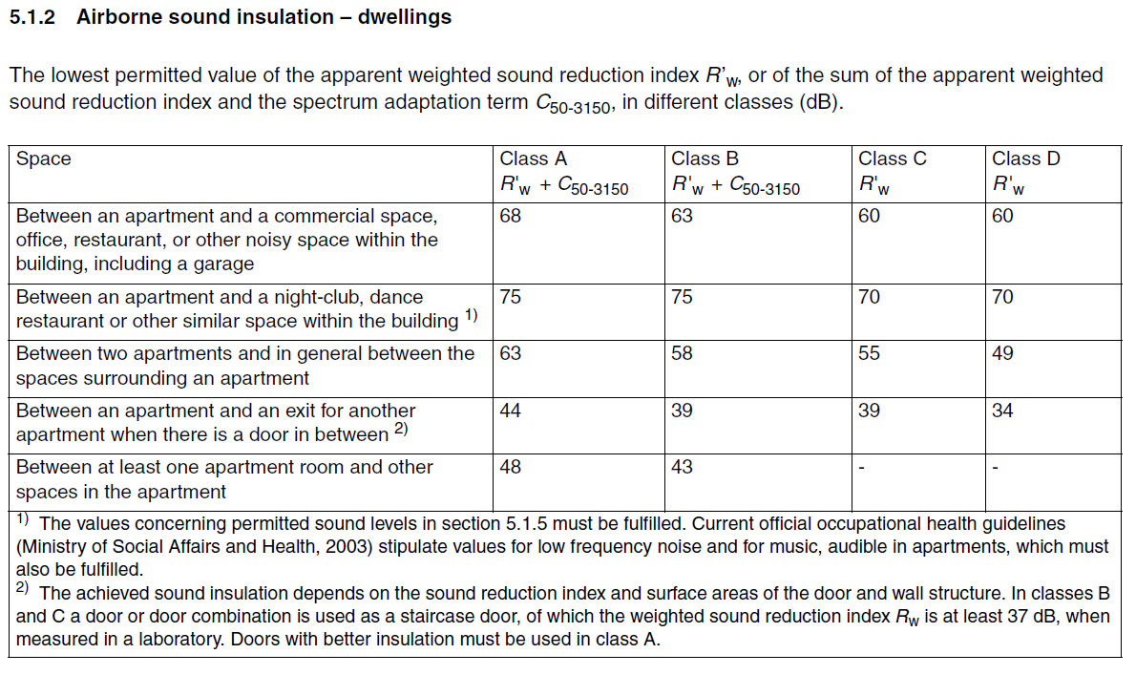

Introduction: Lecture B.3
Why are we learning this?
Regulations!!

Slide 4
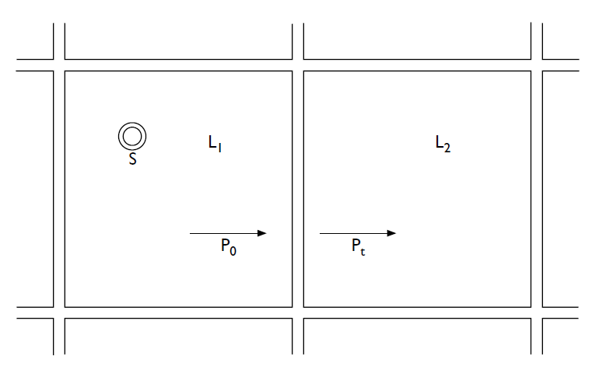


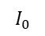
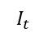
9.2 Sound reduction index combining multiple surfaces
Sound reduction index of multiple elements
$$I_{0}$$
$$I_{t}$$
Source room
Receiver room
Element 3 (door)
Element 2 (window)
Element 1 (wall)

Slide 5
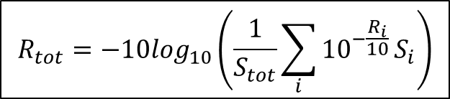
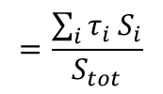
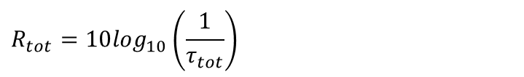
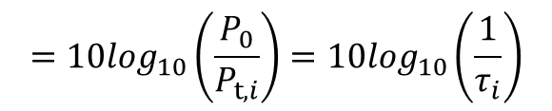
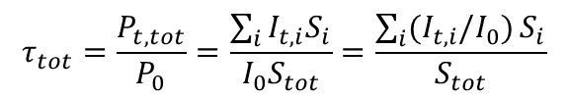
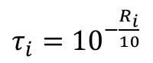
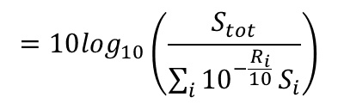
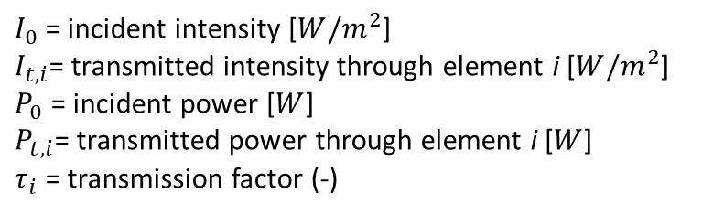
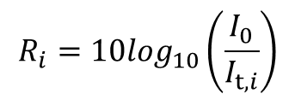
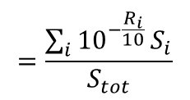
9.2 Sound reduction index combining multiple surfaces
Sound reduction index of multiple elements
Step 1: Sound reduction index of one element i
Step 2: Sound reduction index of multiple elements
Assumption: no interaction between elements
$$R_{i}=10\log_{10}\left(\frac{I_{0}}{I_{t,i}}\right)$$
$$τ_{tot}=\frac{P_{t,tot}}{P_{0}}=\frac{\sum_{i}{I_{t,i}S_{i}}}{I_{0}S_{tot}}=\frac{\sum_{i}{(I_{t,i}/I_{0})}S_{i}}{S_{tot}}$$
$$=10\log_{10}\left(\frac{P_{0}}{P_{t,i}}\right)=10\log_{10}\left(\frac{1}{τ_{i}}\right)$$
$$=\frac{\sum_{i}{{10}^{−\frac{R_{i}}{10}}}S_{i}}{S_{tot}}$$
$$=\frac{\sum_{i}{τ_{i}}S_{i}}{S_{tot}}$$
→
$τ_{i}=$ ${10}^{−\frac{R_{i}}{10}}$
$$R_{tot}=10\log_{10}\left(\frac{1}{τ_{tot}}\right)$$
$$=10\log_{10}\left(\frac{S_{tot}}{\sum_{i}{{10}^{−\frac{R_{i}}{10}}}S_{i}}\right)$$
(Power = Intensity x Area)
$I_{0}$= incident intensity [${W/m}^{2}$]
$I_{t,i}$= transmitted intensity through element i [${W/m}^{2}$]
$P_{0}$= incident power [$W$]
$P_{t,i}$= transmitted power through element i [$W$]
$τ_{i}$ = transmission factor (-)
$$R_{tot}=−10\log_{10}\left(\frac{1}{S_{tot}}\sum_{i}{{10}^{−\frac{R_{i}}{10}}}S_{i}\right)$$

Slide 6

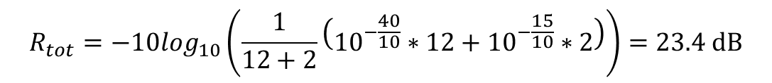
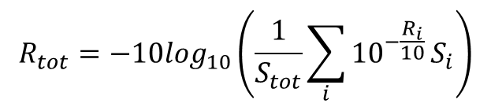
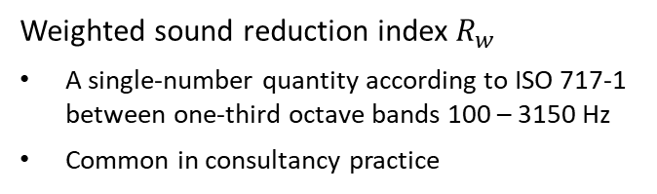
9.2 Sound reduction index combining multiple surfaces
Sound reduction index of multiple elements
Sound reduction index of multiple elements
Why are these just constant values?
Example:
Weighted sound reduction index $R_{w}$
A single-number quantity according to ISO 717-1 between one-third octave bands 100 – 3150 Hz
Common in consultancy practice
S₁ = 12 m²
S₂ = 2 m²
R₁ = 40 dB
R₂ = 15 dB
S₁
$$R_{tot}=−10\log_{10}\left(\frac{1}{S_{tot}}\sum_{i}{{10}^{−\frac{R_{i}}{10}}}S_{i}\right)$$
S₂
$$R_{tot}=−10\log_{10}\left(\frac{1}{12+2}\left({10}^{−\frac{40}{10}}∗12+{10}^{−\frac{15}{10}}∗2\right)\right)=23.4 dB$$
$$S_{tot}$$
Element 1
Element 2

Slide 7
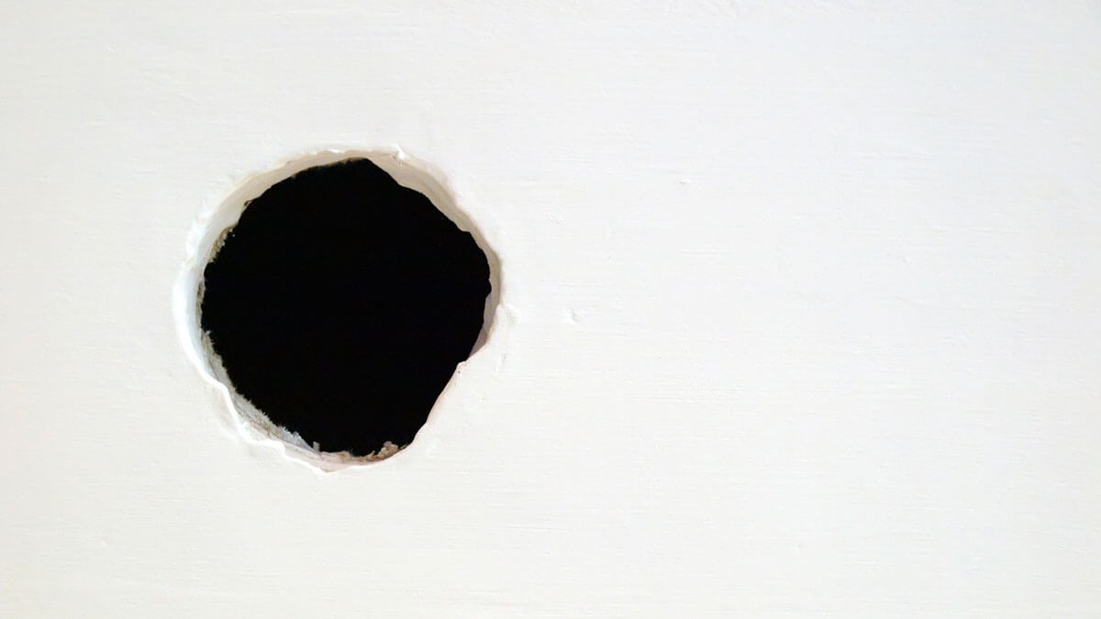
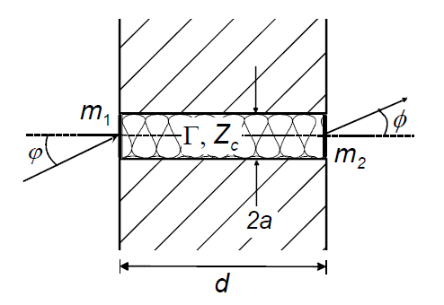
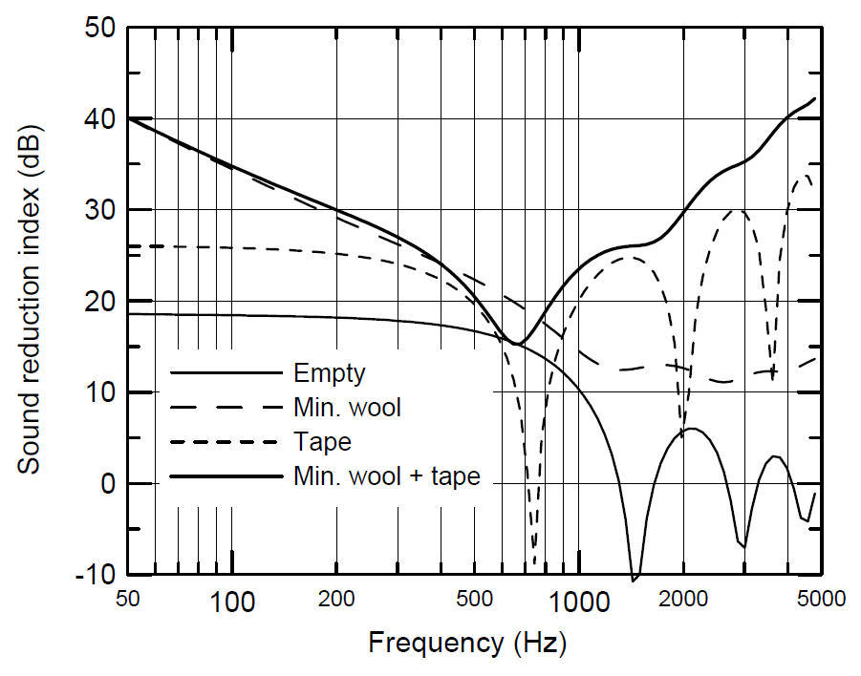
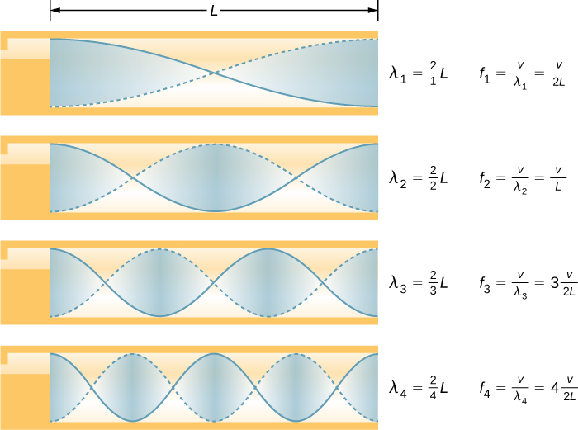
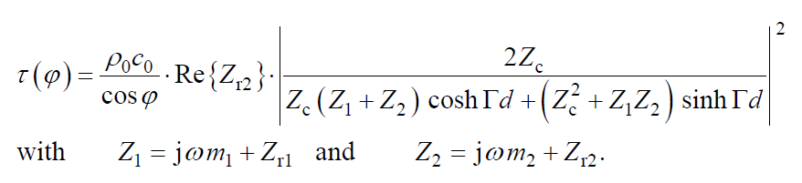
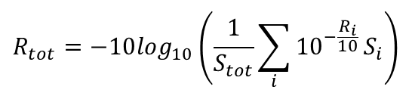
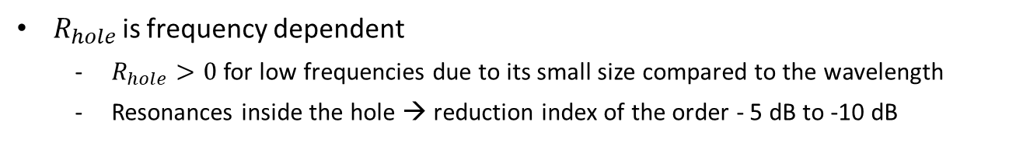
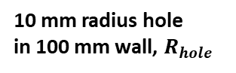
9.2 Sound reduction index combining multiple surfaces
Apertures in partitions
$$R_{tot}=−10\log_{10}\left(\frac{1}{S_{tot}}\sum_{i}{{10}^{−\frac{R_{i}}{10}}}S_{i}\right)$$
Calculation for complete wall with the formula
$R_{hole}=0$?
$R_{hole}$ is frequency dependent
$R_{hole}>0$ for low frequencies due to its small size compared to the wavelength
Resonances inside the hole → reduction index of the order - 5 dB to -10 dB
Circular opening in a wall
10 mm radius hole in 100 mm wall, $R_{hole}$
Resonance modes
Transmission factor for the circular hole

Slide 8
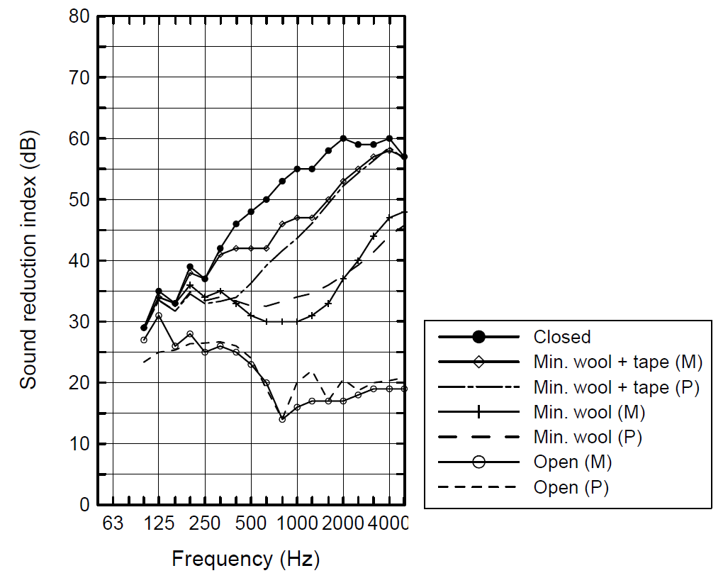
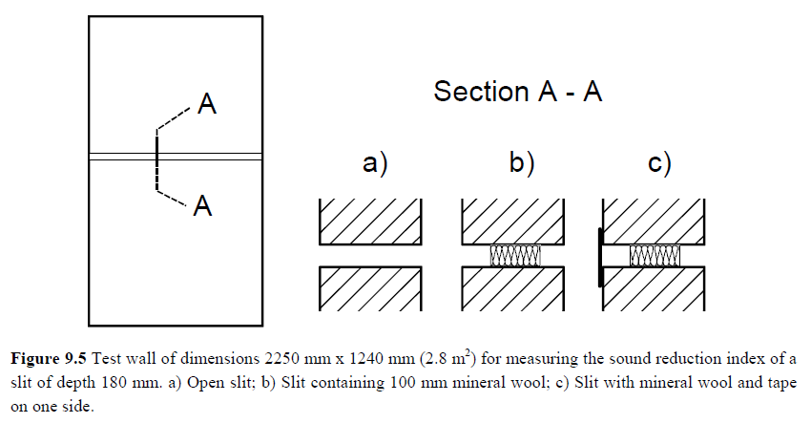
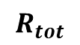




9.2 Sound reduction index combining multiple surfaces
Apertures in partitions
Slit in a wall
$$R_{tot}$$
Wall
Slit
20 mm
180 mm
100 mm
mineral wool
tape
1240 mm

Slide 9
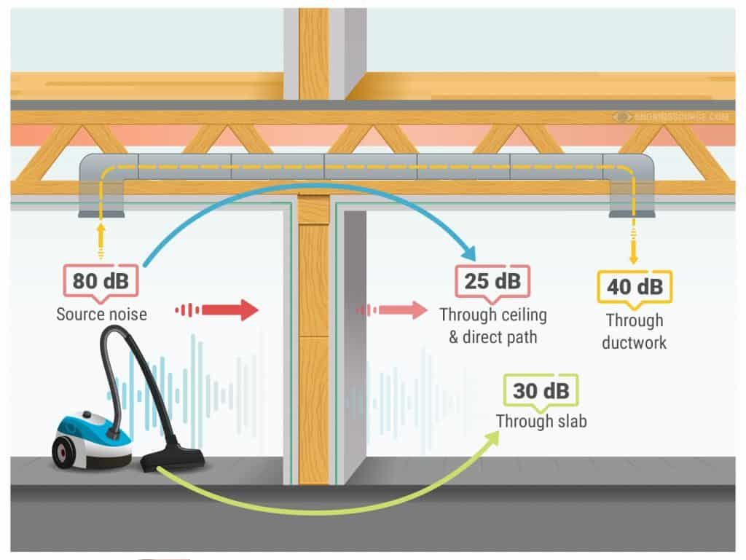
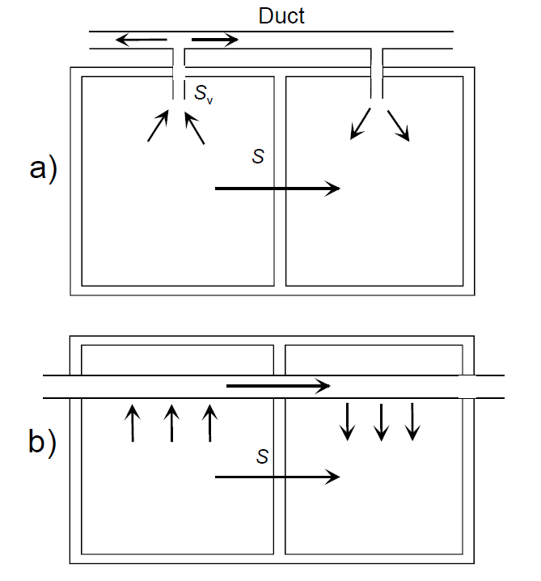
9.2 Sound reduction index combining multiple surfaces
Ducts
Transmission between terminal units

Slide 10

9.2 Sound reduction index combining multiple surfaces
Ducts
Duct
Break-in and Break-out scenario

Slide 11
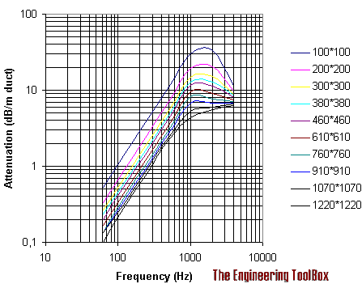
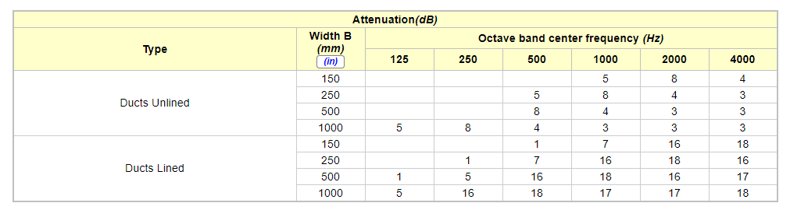
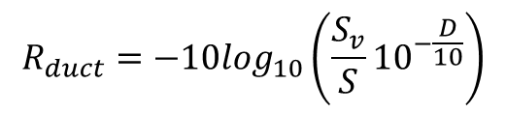
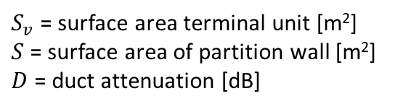
9.2 Sound reduction index combining multiple surfaces
Ducts
$$R_{tot}=−10\log_{10}\left(\frac{1}{S_{tot}}\sum_{i}{{10}^{−\frac{R_{i}}{10}}}S_{i}\right)$$
Calculation for complete wall with the formula
$$R_{duct}=−10\log_{10}\left(\frac{S_{v}}{S}{10}^{−\frac{D}{10}}\right)$$
with
$S_{v}$ = surface area terminal unit [m²]
$S$ = surface area of partition wall [m²]
$D$ = duct attenuation [dB]
Attenuation in duct
https://www.engineeringtoolbox.com/sound-attenuation-ducts-d_75.html
https://www.engineeringtoolbox.com/sound-attenuation-ducts-elbows-d_76.html

Slide 12
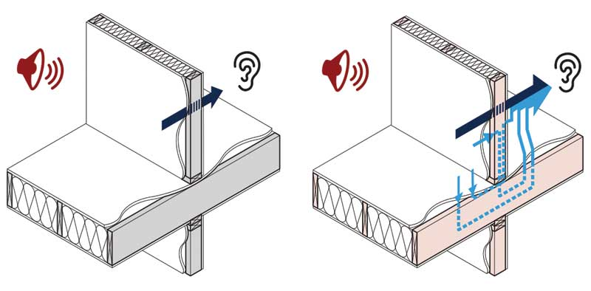
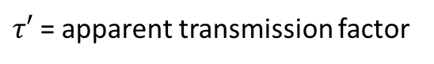
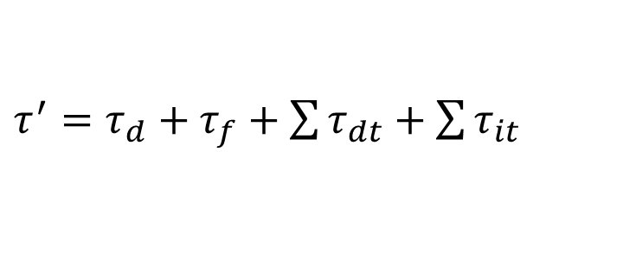
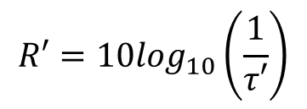
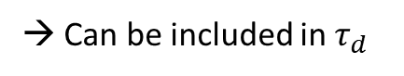
9.3 Flanking sound transmission
Apparent sound reduction index R’
R
R’
$$R′=10\log_{10}\left(\frac{1}{τ′}\right)$$
$τ′$= apparent transmission factor
parts, added to wall (windows, doors apertures, etc.)
direct
→ Can be included in $τ_{d}$
$τ^{′}=τ_{d}+τ_{f}+\sum{τ_{dt}}+\sum{τ_{it}}$
flanking
indirect transmission between rooms
(ducts, suspended ceilings, etc.)

Slide 13
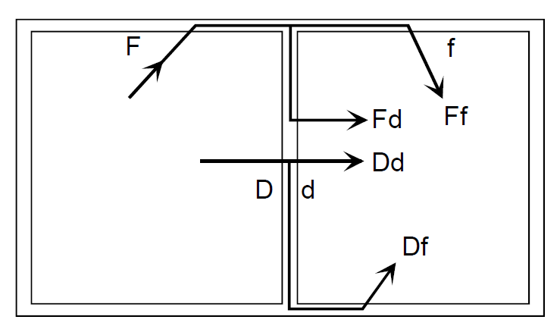
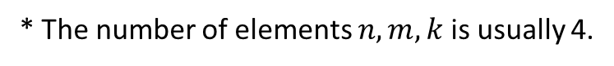
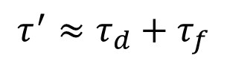
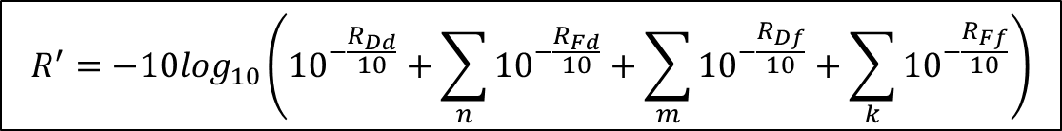


9.3 Flanking sound transmission
Apparent sound reduction index R’
We only consider first order flanking contributions.
Ceiling
Partitioning wall
$$τ^{′}≈τ_{d}+τ_{f}$$
$$τ_{d}{=τ}_{Dd}+\sum_{n}{τ_{Fd}}$$
$$τ_{f}=\sum_{m}{τ_{Df}}+\sum_{k}{τ_{Ff}}$$
Floor
* The number of elements $n,m,k$ is usually 4.
$$R^{′}=−10\log_{10}\left({10}^{−\frac{R_{Dd}}{10}}+\sum_{n}{{10}^{−\frac{R_{Fd}}{10}}}+\sum_{m}{{10}^{−\frac{R_{Df}}{10}}}+\sum_{k}{{10}^{−\frac{R_{Ff}}{10}}}\right)$$
Laboratory measurement

Slide 14



9.3 Flanking sound transmission
Flanking sound reduction index $R_{ij}$
Flanking transmission from element i to element j → $R_{ij}$
element i
element j
$$R_{ij}≈\frac{R_{i}+R_{j}}{2}+K_{ij}+10\log_{10}\left(\frac{S_{S}}{{l_{0}l}_{ij}}\right)$$
$R_{i} \& R_{j}$: Sound reduction index of element i and j
$K_{ij}$: Vibration reduction index
$S_{S}$: Direct transmission surface area
$l_{0}$: Reference length = 1 m
$l_{ij}$: Length between the two elements

Slide 15




9.3 Flanking sound transmission
Vibration reduction index K_{ij}
Definition
Parameter to describe how the vibrations pass from one part of the building to another
Invariant quantity to characterize the transmission across a junction
$$K_{ij}=\overline{D_{v,ij}}+10\log_{10}\left(\frac{l_{ij}}{\sqrt{a_{i}a_{j}}}\right)$$
Surface area of element i
$$\overline{D_{v,ij}}=\frac{D_{v,ij}+D_{v,ji}}{2}$$
: Direction averaged velocity level difference
$D_{v,ij}=10\log_{10}\left(\frac{〈{\tilde{u}}_{i}^{2}〉}{〈{\tilde{u}}_{j}^{2}〉}\right)$: Velocity level difference
Reference frequency, 1000 Hz
$l_{ij}$: Length between the two elements [m]
$a_{i} \& a_{j}$: absorption length of element i and j [m]
Structural reverberation time
time that takes for the construction element to lose 60 dB of its vibration energy

Slide 16


9.3 Flanking sound transmission
Vibration reduction index K_{ij}
By measurement
Measurement setup
for the velocity level difference
Measurement setup
for the structural reverberation time
Master thesis of Smits, J.P.M., TU/e, 2007
https://research.tue.nl/en/studentthesis/vibration-reduction-index-of-junctions-with-double-leaf-separating-walls(1d42342a-3a2f-4571-84f5-daa50cf489c8).html

Slide 17




9.3 Flanking sound transmission
Vibration reduction index K_{ij}
By energy-based model
2
1
3
Source room
Receiver room
4
$$K_{12}=8.7+5.7M^{2}$$
$$K_{13}=8.7+17.1M+5.7M^{2}$$

Slide 18







9.3 Flanking sound transmission
$$R^{′}=−10\log_{10}\left({10}^{−\frac{R_{Dd}}{10}}+\sum_{n}{{10}^{−\frac{R_{Fd}}{10}}}+\sum_{m}{{10}^{−\frac{R_{Df}}{10}}}+\sum_{k}{{10}^{−\frac{R_{Ff}}{10}}}\right)$$
$$R_{ij}≈\frac{R_{i}+R_{j}}{2}+K_{ij}+10\log_{10}\left(\frac{S_{S}}{{l_{0}l}_{ij}}\right)$$
In case of additional damping layer on the flanking elements:
$+{∆R}_{i}$ and/or ${∆R}_{j}$
J.D. Quirt et al., inter-noise 2014, Controlling flanking transmission due to continuous elements in joist floors

Slide 19



9.3 Flanking sound transmission
How to reduce flanking transmission?
Damping layers at junctions
Structural decoupling
Kinetics Noise Control, Inc.

Slide 20




Summary
Lecture B.3
Transmission through multiple surfaces
Flanking sound transmission
Total sound reduction index
Apparent sound reduction index
$$R_{tot}=−10\log_{10}\left(\frac{1}{S_{tot}}\sum_{i}{{10}^{−\frac{R_{i}}{10}}}S_{i}\right)$$
$$R^{′}=−10\log_{10}\left({10}^{−\frac{R_{Dd}}{10}}+\sum_{n}{{10}^{−\frac{R_{Fd}}{10}}}+\sum_{m}{{10}^{−\frac{R_{Df}}{10}}}+\sum_{k}{{10}^{−\frac{R_{Ff}}{10}}}\right)$$
Flanking sound reduction index
S₁
$$R_{ij}≈\frac{R_{i}+R_{j}}{2}+K_{ij}+10\log_{10}\left(\frac{S_{S}}{{l_{0}l}_{ij}}\right)$$
S₂
$$K_{ij}=\overline{D_{v,ij}}+10\log_{10}\left(\frac{l_{ij}}{\sqrt{a_{i}a_{j}}}\right)$$

Slide 22






Building Acoustics Group - Research
https://building-acoustics.net/

